Slide 1
Cue Sheet Project 2.0
Patrick Aung, Kevin Ng, Woody Wu

Slide 2
1. Project Description

Slide 3
Project Description
To revise the first version of the cuesheet project with additional features

Slide 4
2. New Application Features

Slide 5
New Application Features
Select file formats to export & import
Allows users to select .csv, .txt, or .pdf to import & export
Different file export format selections
Ability to select multiple export formatting cuesheet information
Fancy Drag
Make GUI fancier by showing the path of dragged segment vertices
Undo/Redo
Ability to undo/redo action steps on the overall route display

Slide 6
3. New Model Overview

Slide 7
New Model Overview
FileHandler
Superclass that will allow different file format handlers
CSVFileHandler
Extends FileHandler Ito handle .csv files for importing & exporting
TXTFileHandler
Extends FileHandler to handle .txt files for importing & exporting
RouteBank
Helps Route to store its previous states in order to redo/undo
PDFFileHandler
Extends FileHandler to handle .pdf files for importing & exporting

Slide 8
4. Class Diagram

Slide 9
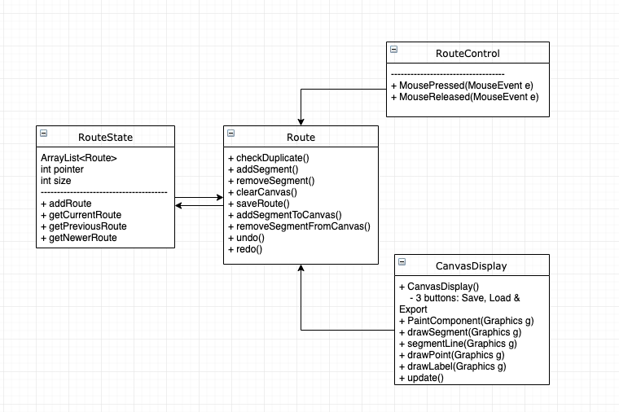
Class Diagram (Undo/Redo)

Slide 10
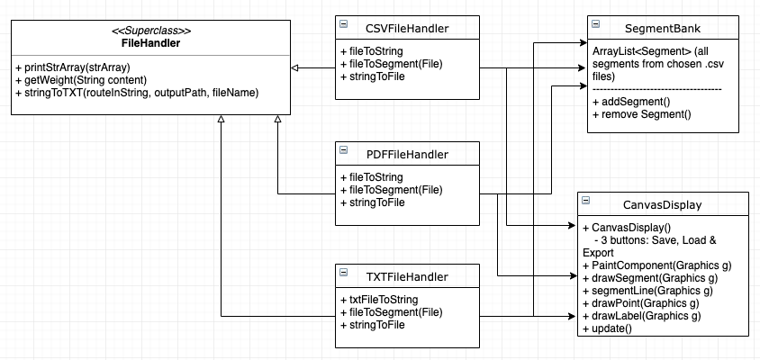
Class Diagram (Import/Export with Multiple File Format)

Slide 11
Questions?

